Slide 1
GOOGLE ONLINE MARKETING CHALLENGE
Ayesha Chacko
Reshmi Krishna
Alice Lee

Slide 2
ADWORDS
Advertisers set maximum Price-per-Click (PPC), either Cost-per-Click of Cost-per-thousand impressions (CPM)
Ad Rank = CPC x Quality Score
Quality Score: Historical CTR, relevance, advertiser’s account history, many other relevant factors

Slide 3
ABOUT THE CHALLENGE
Student teams receive $200 for three consecutive weeks of advertising
Assess results, give recommendations to business

Slide 4
WHY HORIZONS
Small business, <20 employees
Star in a niche market
Little history of advertising
People may be willing to travel to eat there, are looking for a place to eat when they search for a vegetarian restaurant, e.g.

Slide 5
CLIENT PROFILE
Reaches out to vegetarians and pushes the envelope in sophisticated cuisine
  Accommodating to diets and allergies
Supportive and loyal customer base
History
Company presence and sales via online and offline channels
Customers: About 65% are vegetarian
  10% of those are strict vegans

Slide 6
MARKET ANALYSIS
Current and potential customers
  Older, health-conscious crowd and young adventurous couples
Vegetarians in Philadelphia: large and active, more casual
Overview of the industry
  Competition
  Trends
Other relevant market information

Slide 7
CURRENT MARKETING
Website strengths and weaknesses
Website visibility
  Page rank: 5/10
Current use of Google Analytics
  Number of viewers
  Incoming/outgoing links
  Goal setting
Promotions – New Years, Valentines Day, Mothers Day, James Beard House

Slide 8
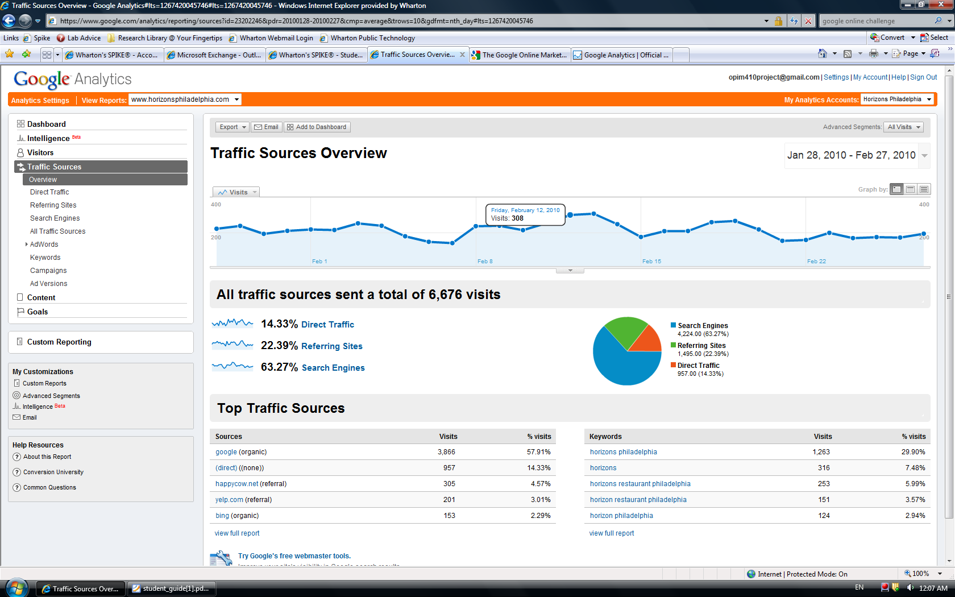
GOOGLE ANALYTICS
Anything it provides…

Slide 9
GOALS
Goal: Expand customer base
How to assess: change in the Click-Through Rates (CTRs) for brand-neutral queries
(graph of current CTRs for keywords)

Slide 10
QUALITIES OF A GOOD CAMPAIGN
Fits within a budget ($200 in our case)
Collects informative, sufficient data
Profitable keywords (low cost-per-click, high CTR)

Slide 11
HOW TO OPTIMIZE OUR CAMPAIGN
Choosing Keywords. Have fewer, more profitable keywords to cut costs and maximize return
Maximizing CTRs. Determine ideal variables that will maximize CTR within our budget.

Slide 12
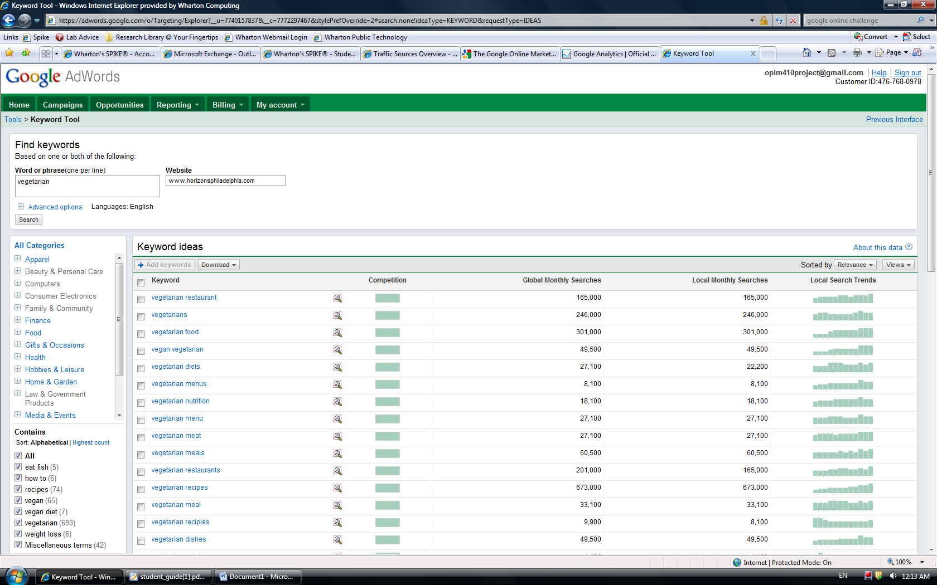
SOME RELEVANT DATA

Slide 13
1. CHOOSING KEYWORDS
Goal: Minimize CPC/CTR for non-branded keywords
Run ~10 keywords for four days
Calculate CPC/CTR for each keyword
Pick the best 4-5

Slide 14
2. MAXIMIZING CTRS
Determine inputs that impact CTR, including characteristics of keywords and CPM/CPC
Get training data from testing various combinations of input variables
Target Variable: CTR
Apply models to determine ideal inputs to maximize CTR

